Slide 1

Portfolio Executive Committee (PEC) Review Meeting
TA CRM
To insert a wordmark:
Add (e.g. via drag and drop) your wordmark file (in RGB) to this slide (in alignment with our brand governance and architecture guidelines)
Change the size of the wordmark according to the height reference (magenta placeholder)
Select the “guides” in the navigation bar and move the wordmark to the right and top line (orange)
  CRM Team | 15-Dec-2025 | 20 min

Slide 2
Part I:
Follow-up Actions from the Previous PEC
PEC action log

Slide 3
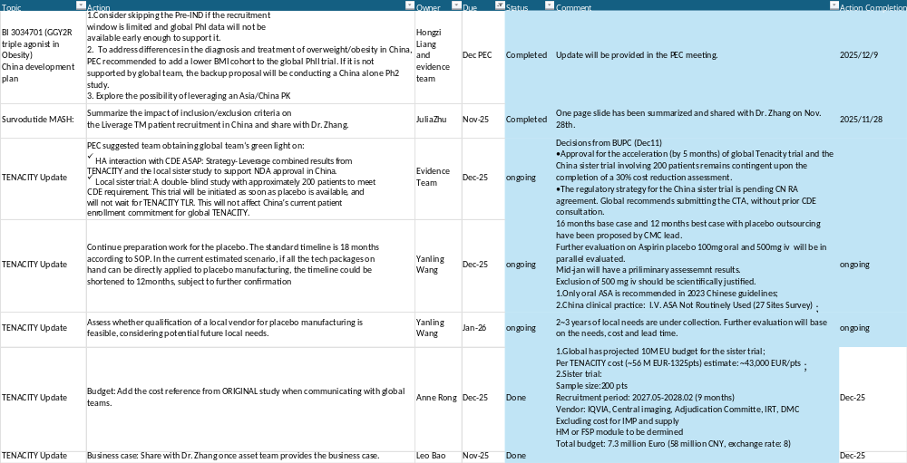

Slide 4
Part II: Update

Slide 5
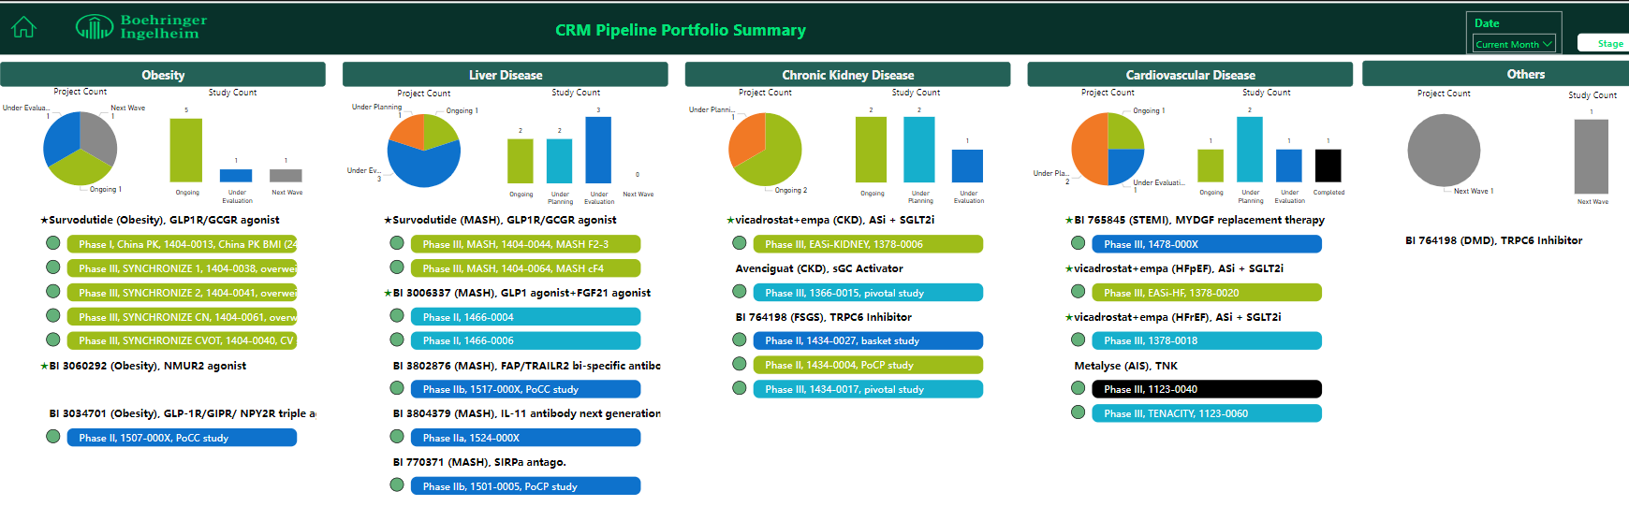
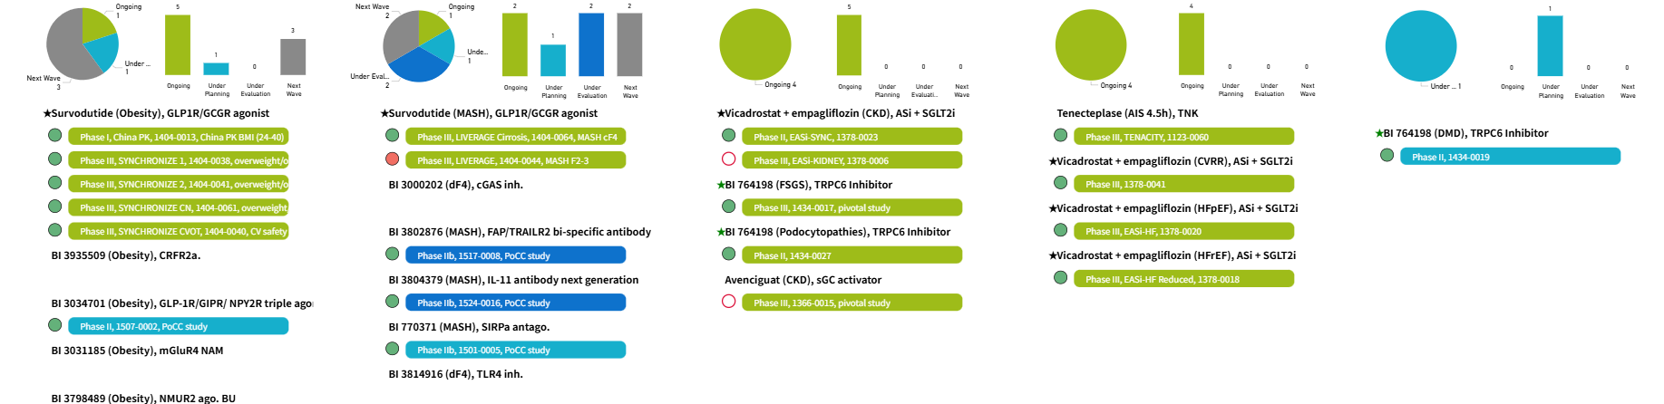
Dec 2024
Dec 2025
No change since last meeting

Slide 6

CRM TA Achievements in 2025
1 BLA approval
1 BTD submission and approval (Global First!)
5 Pre-IND/EoPh II submission
6 CTA submission (1 global first CTA submission,
1 global first EC approval)
More HA interactions for strategy consultation and protocol amendment etc.
4 first site initiation
6 first subject screening
1 last subject completion
9 Investigator Meetings (face-to-face and online)

Slide 7

CRM TA Milestones in 2026
CTA submission
    Avenciguat Ph III in GN (1366-0015)
    BI 3034701 (GGY2Ra.) Ph II in obesity (1507-0002)
    TRPC6i Ph II in DMD (1434-0019)
    BI 7703711 (SIRPa ant.) Ph IIb in MASH
Other HA interaction submission
    Survodutide in obesity for pediatric obesity, CMC pre-NDA, drug-device combination attribution definition
    Survodutide in MASH for NIT
    Survodutide in ALD
    BI 3802876 (FAP/TRAILR2) in MASH for PK backloading
First Site Initiation
    TENACITY (Metalyse in AIS >4.5h, 1123-0060)
    TRPC6i Ph III in pFSGS (1434-0017)
    TRPC6i Ph II in podocytopathies (1434-0027)
    TRPC6i Ph II in DMD (1434-0019)
    Avenciguat Ph III in GN (1366-0015)
    BI 3034701 (GGY2Ra.) Ph II in obesity (1507-0002)
    BI 7703711 (SIRPa ant.) Ph IIb in MASH
Last Subject Completion and Key results
    SYNCHRONIZE I, II, CVOT and CN

Slide 8
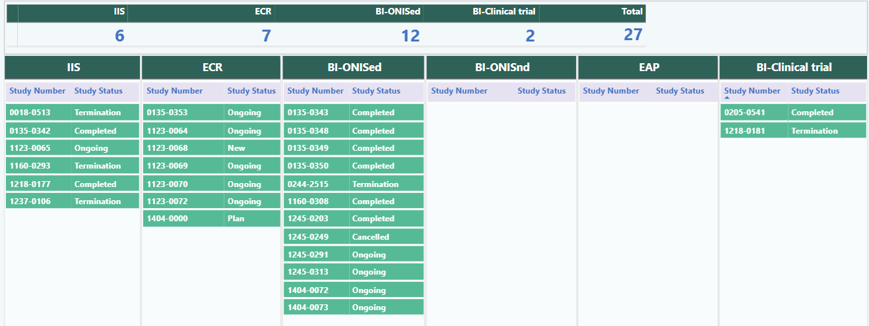
TA CRM Portfolio Summary - PMS Studies
No change since last meeting

Slide 9
TA Review Meeting
Mature Product Overview Metabolism
Product | ·Indication | Study type/Global Status (Study no.: FPI-LPO, CTR) | China Dev. Strat. | Current status | Next Mile-stone | Key Updates
Jardiance (Empagliflozin) | HFrEF | China local NISed (1245.0291:Nov 2021-Dec 2030) | China alone | IEC approval | Feasibility analysis 1 (2026 Jan) | Current database enrolment delay: due to VBP, and drug switch situation HAI was sent on Jan 20th, feedback on May 14th Monthly meeting with PI to go through: latest database enrolment, issues etc. Total 1450 as of Nov2025. Plan to make an onsite visit to communicate the CDE submission file, feasibility analysis and latest database enrolment
Jardiance (Empagliflozin) | HFpEF | China local NISed (1245.0313:Q4 2022-Dec 2030) | China alone | IEC approval | Feasibility analysis 1 (2026 Jan) | Current database enrolment delay: due to VBP, and drug switch situation HAI was sent on Jan 20th, feedback on May 14th Monthly meeting with PI to go through: latest database enrolment, issues etc. Total 1450 as of Nov2025. Plan to make an onsite visit to communicate the CDE submission file, feasibility analysis and latest database enrolment

Slide 10
Challenges and next step
Issues |  | Follow up action | Timeline
Study progress report to CDE | Lack of latest data | Urge PI to provide the data and review the content of CDE file Check the database on-site | Continuously communicate with PI Completed and found some issues
Current status of data | Available patients: 1,790 in the database; Unclear diagnosis record of HFrEF/HFpEF; Unstructured data including drug prescription and lab test ; Lack of follow-up data | Communicate with PI to improve database quality: Improve diagnosis record of HFrEF and HFpEF Need further data curation for unstructured data Improve follow-up visit record | Next on-site visit (expected within this week)
PI challenge | Negative collaboration | Further engagement with PI | Continuously

Slide 11
Metalyse

Slide 12




Metalyse Development Plan (TENACITY - Late time window indication)
today
2025 |  |  |  | 2026 |  |  |  | 2027 |  |  |  | 2028 |  |  |  | 2029
Q1 | Q2 | Q3 | Q4 | Q1 | Q2 | Q3 | Q4 | Q1 | Q2 | Q3 | Q4 | Q1 | Q2 | Q3 | Q4 | Q1 | Q2 | Q3 | Q4
Jan 13
Mar 27
4 Nov 2025
Feb 2026
Jul 2027
Nov 2027
Jan 2028
Apr 2028
CTA Review + 1st SIV
Ph3, N=1325
Apr 2029
EU
1st SIV
LPI
DBL
(Key results +1W)
CSR
NDA app.
Pre - IND
CTA Sub
NDA sub.
Jan 10
May 28
8 Aug 2025
Feb 2026
Jul 2027
Nov 2027
Jan 2028
May 2028
May 2029
China
CTA Review + EC + HGRAC + 1st SIV
Ph3, 30 sites, N=~339
1st SIV
LPI
DBL
(Key results +1W)
NDA sub.
NDA app.
Pre - IND
CTA Sub
CSR

Slide 13
Metalyse development plan
Dec 2025
2025 |  |  |  | 2026 |  |  |  | 2027 |  |  |  | 2028 |  |  |  | 2029 |  | 2030
Q1 | Q2 | Q3 | Q4 | Q1 | Q2 | Q3 | Q4 | Q1 | Q2 | Q3 | Q4 | Q1 | Q2 | Q3 | Q4 | H1 | H2 | H1 | H2
Global
TENACITY
Previous timeline
(~5m acceleration, TBC by global)
CTA Review + 1st SIV
Ph3, N=1325 (China ~ 340pts), 18M
EU NDA sub.
Apr 2028
EU NDA app.
Apr 2029
CTA-s
4 Nov 2025
1st SIV
Feb 2026
LPI
Jul 2027
DBL
Nov 2027
CSR
Jan 2028
Global Study Team requests China to achieve 25% enrollment in TENACITY (base/best cases)
IMP readiness for site shipment: Metalyse + Antiplatelet (Placebo) ~16 M
Apr 2027
China
Join TENACITY as original plan and conduct a China blinding sister trial in parallel
Base case
TDO
HAI（15+60WD)
Placebo IMPD Prep**
CTA Review
EC -approval
N=200 (9 M)
Dec 2025
Jan 2026
Apr 2026
CTA-s
Nov 2026
EC-s
Feb 2027
SIV
May 2027
LPI
Feb 2028
DBL
Jun 2028
CSR
Aug 2028
NDA sub.*
Oct 2028
NDA app.
Oct 2029
*
IMP readiness for site shipment: Metalyse + Antiplatelet (Placebo) ~12 M***
Dec 2026
Best case
TDO
HAI（15+60WD)
Placebo IMPD Prep**
CTA Review
EC -approval
N=200 (9 M)
Dec 2025
Jan 2026
Apr 2026
CTA-s
Jul 2026
EC-s
Oct 2026
SIV
Jan 2027
LPI
Oct 202
DBL
Feb 2028
CSR
Apr 2028
NDA sub.*
Jun 2028
NDA app.
Jun 2029
* China NDA submissions must include results from the TENACITY trial and sister trial.
**Placebo IMPD preparation timeline will be further evaluated once placebo candidate is selected.
*** Under evaluation by Global team

Slide 14
Key Update on Metalyse China Late Time Window (LTW) Indication Development
The decision from BUPC (11 Dec 2025)
Approval for the acceleration (by 5 months) of global Tenacity trial and the China sister trial involving 200 patients remains contingent upon the completion of a 30% cost reduction assessment – Based on informal communications, the global team will prioritize the budget for the China sister trial
Global recommends submitting the CTA directly, without pre-IND. (concerns: CDE may not give clear feedback; even mandate a full-power trial). The regulatory strategy for the China sister trial is pending CN RA agreement.

Slide 15
Survodutide

Slide 16


Survodutide/MASH Development Plan
2024 |  |  |  | 2025 |  |  |  | 2026 |  |  |  | 2027 |  | 2025 |  | 2028 |  |  |  | 2029
Q1 | Q2 | Q3 | Q4 | Q1 | Q2 | Q3 | Q4 | Q1 | Q2 | Q3 | Q4 | Q1 | Q2 | Q3 | Q4 | Q1 | Q2 | Q3 | Q4 | H1 | H2
Global
Accelerated sub/appr (F2/3): Oct 2027/Mar 2028
Ph3-1404.44
FOS trial
19 Oct 2024
May 2027
Jan 2028
Mar2032
Mar2024
EoP2 sub
MASH F2/3
FSS
Interim analysis
LSR
DBL
Ph3-1404.64
FOS trial
19 Oct 2024
Jul 2029
FSS
LSR
DBL
Dec 2027
Full sub/appr (F2-4): Sep2029/Feb 2030
By 1st Dec, LIEVERAGE had 168 (+27) pts screened, 8 (+4) randomized, 56 in screening; LIVERAGE-Cirrhosis had 60 (+9) pts screened, 21 (+2) randomized, 15 in screening.
Virtual NCI Lead Call was held on 3rd Dec.
Global submitted HAI on NIT related questions to FDA, meeting is planned on 9th Jan, 2026. Local kick-off is planned in late Dec.
China
Ph3-1404.44
FOS trial
18 Oct
CTA a
17 Jan
2024
Mar
EoP2 s
6 Aug
CTA s
FSS
Ph3-1404.64
FOS trial
Full sub/appr (F2-3): Nov 2032/Sept 2033 (best) Feb 2034 (base
27 Jan
2024
FSS
We are here
16
Accelerated sub/appr (F2/3): Nov 2027/Aug 2028 (best&base)
Full sub/appr (F2-4): Oct 2029/Jul 2030 (best) Dec 2030 (base
Notes:
CTA+EC+HGRAC+1st SIV=4.5m

Slide 17
Projects/Studies with Red-Light – China Mainland
Project/study
Red-light starts from
Survodutide, GCGR/GLP-1R dual agonist,
in MASH/1404-0044, PhIII
Aug 2025
Status Update
Enrolment period of part one is announced to extend to Jul 2026 in late Oct 2025.
Recruitment is behind the plan in LIVERAGETM in China
By 1 Dec, CN has screened 168 (+27), randomized 8 (+4) [17 as planned for Nov], screen failed 105, in screening 56;
Main challenges for China including intensive competition, high SF rate, site performance low (no scr. >5 weeks since activation)
Site Engagement Plan
By 1 Dec, Totally 85 site engagement visits completed by BI China team. 18 sites planned to have engagement visit.
Under discussion on the collaborate site engagement visit between BI and PXL COLs upon tiers.
National Coordinate Investigator (NCI) lead call and NCIs call with Julian done on 3 Dec 2025
FTF IM planned in Mar-Apr 2026, under discussion for Study Recruitment Award
Global NCIs Call planned in Mid Dec 2025.
Other Mitigation Actions
2 Recruitment Vendors to be involved for Liverage Cirrhosis in Mid Dec 2025 (Potential contribution to Liverage)
Finalized the narratives for NIT competitive study and plan to distribute to local BI & PXL team.
Global approved the CN Investigator Fee (IF)s increase and pt stipends increase, currently under implementation by PXL, expected to complete by end of Jan 2026.
Monthly BI CN-global exchanging meeting with Global team to discuss hurdles.
Global Pathologist and Vendor for biopsy review/collection training on 17Dec2025 for investigators and local pathologists to decrease the biopsy SF rate
Strengthen collaboration between local pathologists and investigators to minimize biopsy screen failures
Additional 10 sites for feasibility and selection, currently 1 new site selected.
Discussed potential sites for closure (current 7 sites) based on site performance and global guidance.
Notes:
Total Screened = 60
Total Randomized = 21
Total SF= 24
SFR= 53.33%

Slide 18
LIVERAGE Medical Head Exchange meeting - Follow up action updates
Date: 21 Nov. 2025, 9:00-10:00 Topics: Status and key asks of LIVERAGE trial, 45min
 | Follow-up actions | Responsible person | Timeline | Status
1 | Need immediate action for formal release and detailed plan of EAP/Drug Voucher (e.g. the duration of drug compensation) from global | Elena | By the middle of Dec 2025 | EC endorsed the drug vouchers proposal, to provide Survo for 1 year in feasible countries. Next to discuss with global trial team on ICF wording and timeline.
2 | Solid global plan to support the Patients who progress to liver outcome events | Not discussed in the meeting, which need comments from Elena and Luiza by the end of Dec 2025. |  | Topic set in next Global-CN Catch-up (13 Jan, 2026)
3 | A centralized pathological training to be implemented ASAP | David and Katarina Vajdova | By the end of Dec 2025 | The training is planned on 17 Dec
4 | A direct case-by-case scientific discussion platform between local and central pathologists on biopsy cases with discrepancy for educational purpose only | Luiza | By Dec 2nd, 2025 | After the centralized pathological training completion, Luiza will follow-up with the central pathologists.
5 | Push Parexel(PXL) team to have the draft contract delivered to the sites of the increased CN Investigator Fee (IF)s and pt stipends | David | By the end of Nov 2025 | Verbal communication has been done by PXL team.
6 | Push Parexel(PXL) team to have the site contract implementation of the increased CN Investigator Fee (IF)s and pt stipends | David | By the end of Jan 2026 | Ongoing
7 | Global narrative on differentiation of Lilly SYNERGY-Outcome trial from the patient perspective | Luiza | By the middle of Dec 2025 | Narrative developed by study physician and commented by China team.
8 | Visit Prof. Vincent Wong of Prince of Wales Hospital to explore any experience could be implemented in China Mainland | Wei/Emma | By end of Dec 2025* | Visit was done on 3 Dec, visit summary was shared to both China and global teams.

Slide 19
Projects/Studies with Red-Light - Taiwan
Project/study
Red-light starts from
Survodutide, GCGR/GLP-1R dual agonist,
in MASH/1404-0044, PhIII
Aug 2025
Status update
By 8 Dec, TW has screened 52(+32 since end of Aug, +10 since end of Nov), randomized 1 (+1 since end of Aug) [should enrolled 2 as planned], screen failed 31, in screening 20;
By 8 Dec, Totally 10 site engagement visits completed by BI Taiwan team. 1 site (TWN1) unavailable by Dec 2025 so planned to have further engagement in the near future.
PXL TWN Boost Recruitment Visit Plan submitted for Global PXL team approval.
Key issues
Recruitment is behind the plan in LIVERAGETM for both global and Taiwan;
Main challenges in Taiwan including high SF rate (Biopsy result failed), half sites not proactive enough with low performance (screen 1 patient per month), 2-3 sites have strict prescreen, PXL local team communication frequency and efficiency with sites are not satisfactory, etc.
10 site booster visits have been conducted from Aug 2025 until now. Overall performance has increased which can be reflected in screening activities, however not reflected in enrollment, there is 1 potential subject might have high possibility to be enrolled in Dec 2025 or Jan 2026.
National Coordinator will be starting to connect sites for recruitment.
Have 1 additional sites proposed for feasibility and selection.
Discussion in increasing site staff fee for prescreening and retention activities.
Discussion in possibility of study information/materials posted in public area or shared to district hospital.
Discussion in possibility to held a local investigator meeting in Jan 2026, but may extend to Mar 2026 due to year end and upcoming Lunar New Year.
Mitigation actions
Notes:
Financial: 研究者费，提升，逐步审批中；患者补贴，已提交 (Biopsy proposed to Global； MRII, 内窥镜补贴提交global for review) ；患者关怀礼物，已提交，待审批；
Study design: will be discussed with global team
Site engagement
Pt screen number vendor onboard后变化
8 sites are Tier-1 (13); 13 sites are Tier-2 (19)
12 sites are Tier-3 (18); 4 sites are Tier-4 (4)
1 site is Only for Liverage Cirrhosis

Slide 20
Projects/Studies with Yellow-Light – Hong Kong
Project/study
Red-light starts from
Survodutide, GCGR/GLP-1R dual agonist,
in MASH/1404-0044, PhIII
Aug 2025
Status update
By 01 Dec, HK has screened 11 (+2), randomized 1 [2 as planned], screen failed 5, in screening 5;
Key issues
Main challenges in Hong Kong including low performance of site for recruitment (screen 1 patient per month), high SF rate, etc.
Mitigation actions
The booster recruitment visit for both sites were planned. HKG1 with the accompany of Dr. Zhang, Emma, Karen, Dave was conducted on 3 Dec 2025. HKG 2 planned in Q4 2025.
Pre-screening activities initiated at both sites, leading to the increase of recruitment (+2) in both of the studies.
Planned virtual site engagement meeting on 18Dec2025.
Plan to discuss the enrolment target increase for HKG1.
Plan to invite Hong Kong sites for FTF IM in Mar-Apr 2026.
Notes:
High SF Ratio: Currently no trends for SF ratio. 1 biopsy results, 1 patient decision, 2 others (using prohibited CM, and 1 upon investigator’s decision)

Slide 21




1404-0044 LiverageTM dated on 01Dec2025 (Global recruitment status)
Total Screened = 3629
Total Randomized = 226
Total SF=2690
SFR=92.25%
Total sample size for part 1 is 700, TCM sample size 12% of 700, ~84
Months | 2024-10 | 2024-11 | 2024-12 | 2025-01 | 2025-02 | 2025-03 | 2025-04 | 2025-05 | 2025-06 | 2025-07 | 2025-08 | 2025-09 | 2025-10 | 2025-11 | 2025-12 | 2026-01 | 2026-02 | 2026-03 | 2026-04 | 2026-05 | 2026-06 | 2026-07 | 2026-08 | 2026-09 | 2026-10 | 2026-11 | 2026-12 | 2027-01 | 2027-02 | 2027-03 | 2027-04 | 2027-05
Screening (planned) | 26 | 41 | 55 | 97 | 246 | 482 | 779 | 1110 | 1491 | 1977 | 2417 | 3028 | 3271 | 3530 | 3788 | 4076 | 4302 | 4584 | 4853 | 5180 | 5666 | 6191 | 6696 | 7235 | 7752 | 8255 | 8795 | 9314 | 9762 | 10135 | 10165 | 10165
Screening (Actual) | 33 | 42 | 55 | 129 | 266 | 534 | 808 | 1145 | 1550 | 1986 | 2402 | 2800 | 3209 | 3629
Randomized (Planned) | 0 | 1 | 1 | 1 | 3 | 7 | 17 | 31 | 50 | 77 | 106 | 135 | 180 | 232 | 290 | 347 | 401 | 463 | 520 | 580 | 639 | 700 | 811 | 925 | 1041 | 1152 | 1267 | 1382 | 1488 | 1603 | 1712 | 1800
Randomized (Actual) | 0 | 1 | 1 | 1 | 3 | 8 | 18 | 35 | 52 | 78 | 108 | 143 | 194 | 226
Clinical Development
and Operations
Notes:
SF Reason: Biopsy (22%), FAST/VCTE/Fibro (11%), AST (9%)

Slide 22
1404-0044 LiverageTM dated on 01Dec2025 (China recruitment status)
Total Screened = 168
Total Randomized = 8
Total SF=105
SFR=92.92%
Total sample size for part 1 is 700, TCM sample size 12% of 700, ~84
Months | 2024-10 | 2024-11 | 2024-12 | 2025-01 | 2025-02 | 2025-03 | 2025-04 | 2025-05 | 2025-06 | 2025-07 | 2025-08 | 2025-09 | 2025-10 | 2025-11 | 2025-12 | 2026-01 | 2026-02 | 2026-03 | 2026-04 | 2026-05 | 2026-06 | 2026-07 | 2026-08 | 2026-09 | 2026-10 | 2026-11 | 2026-12 | 2027-01 | 2027-02 | 2027-03 | 2027-04 | 2027-05
Screening (planned) | 0 | 0 | 0 | 0 | 1 | 3 | 9 | 17 | 33 | 60 | 81 | 186 | 226 | 273 | 319 | 366 | 405 | 452 | 492 | 538 | 598 | 658 | 717 | 784 | 843 | 903 | 969 | 1029 | 1089 | 1136 | 1136 | 1136
Screening (Actual) | 0 | 0 | 0 | 1 | 1 | 3 | 12 | 19 | 37 | 61 | 83 | 109 | 141 | 168
Randomized (Planned) | 0 | 0 | 0 | 0 | 0 | 0 | 0 | 0 | 0 | 1 | 2 | 4 | 11 | 17 | 24 | 30 | 36 | 43 | 50 | 57 | 64 | 70 | 79 | 89 | 98 | 107 | 117 | 126 | 134 | 144 | 153 | 159
Randomized (Actual) | 0 | 0 | 0 | 0 | 0 | 0 | 0 | 0 | 0 | 1 | 2 | 3 | 4 | 8
Clinical Development
and Operations
Notes:
SF Reason: Biopsy results 44%, Fibroscan data 20%, Lab results 16%

Slide 23

1404-0044 LiverageTM dated on 1Dec2025 (Taiwan recruitment status)
Total Screened = 50
Total Randomized = 1
Total SF=24
SFR=96%
Months | 2024-10 | 2024-11 | 2024-12 | 2025-01 | 2025-02 | 2025-03 | 2025-04 | 2025-05 | 2025-06 | 2025-07 | 2025-08 | 2025-09 | 2025-10 | 2025-11 | 2025-12 | 2026-01 | 2026-02 | 2026-03 | 2026-04 | 2026-05 | 2026-06 | 2026-07 | 2026-08 | 2026-09 | 2026-10 | 2026-11 | 2026-12 | 2027-01 | 2027-02 | 2027-03 | 2027-04 | 2027-05
Screening (planned) | 0 | 0 | 0 | 0 | 0 | 0 | 1 | 3 | 7 | 13 | 20 | 39 | 46 | 52 | 52 | 59 | 66 | 72 | 72 | 92 | 112 | 139 | 159 | 185 | 205 | 225 | 252 | 272 | 293 | 293 | 293 | 293
Screening (Actual) | 0 | 0 | 0 | 0 | 0 | 0 | 1 | 3 | 8 | 13 | 20 | 34 | 40 | 50
Randomized (Planned) | 0 | 0 | 0 | 0 | 0 | 0 | 0 | 0 | 0 | 0 | 0 | 1 | 2 | 2 | 3 | 4 | 5 | 5 | 6 | 7 | 8 | 9 | 12 | 15 | 18 | 22 | 25 | 29 | 32 | 35 | 38 | 41
Randomized (Actual) | 0 | 0 | 0 | 0 | 0 | 0 | 0 | 0 | 0 | 0 | 0 | 1 | 1 | 1
Clinical Development
and Operations

Slide 24
1404-0044 LiverageTM dated on 1Dec2025 (Hong Kong recruitment status)
Total Screened = 11
Total Randomized = 1
Total SF=5
SFR=83.33%
Months | 2024-10 | 2024-11 | 2024-12 | 2025-01 | 2025-02 | 2025-03 | 2025-04 | 2025-05 | 2025-06 | 2025-07 | 2025-08 | 2025-09 | 2025-10 | 2025-11 | 2025-12 | 2026-01 | 2026-02 | 2026-03 | 2026-04 | 2026-05 | 2026-06 | 2026-07 | 2026-08 | 2026-09 | 2026-10 | 2026-11 | 2026-12 | 2027-01 | 2027-02 | 2027-03 | 2027-04 | 2027-05
Screening (planned) | 0 | 0 | 0 | 0 | 0 | 0 | 0 | 2 | 4 | 4 | 5 | 5 | 12 | 12 | 12 | 19 | 19 | 26 | 26 | 26 | 33 | 48 | 55 | 70 | 84 | 91 | 106 | 120 | 128 | 142 | 150 | 150
Screening (Actual) | 0 | 0 | 0 | 0 | 0 | 0 | 0 | 2 | 4 | 4 | 5 | 5 | 6 | 11
Randomized (Planned) | 0 | 0 | 0 | 0 | 0 | 0 | 0 | 0 | 1 | 1 | 1 | 1 | 1 | 2 | 2 | 2 | 3 | 3 | 4 | 4 | 4 | 5 | 6 | 8 | 10 | 11 | 13 | 15 | 16 | 18 | 20 | 21
Randomized (Actual) | 0 | 0 | 0 | 0 | 0 | 0 | 0 | 0 | 1 | 1 | 1 | 1 | 1 | 1
Clinical Development
and Operations
Notes:
1 biopsy results, 1 Fibroscan, 1 patient decision, 2 others (using prohibited CM, and 1 upon investigator’s decision)

Slide 25
1404-0064 LiverageTM - Cirrhosis dated on 1Dec2025 (Global recruitment status)
Total Screened = 1252
Total Randomized = 322
Total SF= 581
SFR= 64.34%
Months | 2024-10 | 2024-11 | 2024-12 | 2025-01 | 2025-02 | 2025-03 | 2025-04 | 2025-05 | 2025-06 | 2025-07 | 2025-08 | 2025-09 | 2025-10 | 2025-11 | 2025-12 | 2026-01 | 2026-02 | 2026-03 | 2026-04 | 2026-05 | 2026-06 | 2026-07 | 2026-08 | 2026-09 | 2026-10 | 2026-11 | 2026-12 | 2027-01 | 2027-02 | 2027-03 | 2027-04 | 2027-05 | 2027-06 | 2027-07 | 2027-08 | 2027-09 | 2027-10 | 2027-11 | 2027-12 | 2028-01 | 2028-02 | 2028-03
Screening (planned) | 0 | 0 | 0 | 4 | 12 | 26 | 48 | 82 | 132 | 208 | 294 | 398 | 496 | 598 | 714 | 830 | 940 | 1066 | 1184 | 1298 | 1428 | 1556 | 1676 | 1794 | 1916 | 2050 | 2174 | 2294 | 2406 | 2540 | 2652 | 2782 | 2906 | 3030 | 3156 | 3180 | 3180 | 3180 | 3180 | 3180 | 3180 | 3180
Screening (Actual) | 0 | 1 | 2 | 5 | 21 | 52 | 128 | 265 | 447 | 591 | 740 | 899 | 1077 | 1252
Randomized (Planned) | 0 | 0 | 0 | 0 | 1 | 2 | 6 | 14 | 26 | 43 | 71 | 112 | 156 | 206 | 259 | 310 | 364 | 424 | 478 | 541 | 605 | 660 | 723 | 787 | 848 | 903 | 968 | 1036 | 1090 | 1155 | 1212 | 1282 | 1340 | 1402 | 1463 | 1525 | 1587 | 1590 | 1638 | 1691 | 1740 | 1793
Randomized (Actual) | 0 | 0 | 0 | 0 | 0 | 1 | 10 | 25 | 57 | 106 | 148 | 215 | 281 | 322
Clinical Development
and Operations

Slide 26
1404-0064 LiverageTM - Cirrhosis dated on 01Dec2025 (China recruitment status)
Total Screened = 60
Total Randomized = 21
Total SF= 24
SFR= 53.33%
Months | 2024-12 | 2025-01 | 2025-02 | 2025-03 | 2025-04 | 2025-05 | 2025-06 | 2025-07 | 2025-08 | 2025-09 | 2025-10 | 2025-11 | 2025-12 | 2026-01 | 2026-02 | 2026-03 | 2026-04 | 2026-05 | 2026-06 | 2026-07 | 2026-08 | 2026-09 | 2026-10 | 2026-11 | 2026-12 | 2027-01 | 2027-02 | 2027-03 | 2027-04 | 2027-05 | 2027-06 | 2027-07 | 2027-08 | 2027-09 | 2027-10 | 2027-11
Screening (planned) | 0 | 0 | 0 | 1 | 7 | 11 | 24 | 33 | 37 | 41 | 51 | 61 | 70 | 79 | 90 | 101 | 111 | 121 | 131 | 141 | 151 | 161 | 171 | 180 | 190 | 200 | 207 | 215 | 225 | 235 | 243 | 253 | 261 | 271 | 273 | 273
Screening (Actual) | 0 | 0 | 0 | 1 | 7 | 11 | 23 | 32 | 36 | 40 | 50 | 60
Randomized (Planned) | 0 | 0 | 0 | 0 | 0 | 3 | 5 | 10 | 13 | 18 | 19 | 21 | 26 | 30 | 35 | 39 | 44 | 48 | 53 | 58 | 62 | 67 | 71 | 76 | 80 | 85 | 89 | 94 | 99 | 103 | 108 | 112 | 117 | 121 | 126 | 131
Randomized (Actual) | 0 | 0 | 0 | 0 | 0 | 3 | 5 | 10 | 13 | 18 | 19 | 21
Clinical Development
and Operations

Slide 27
1404-0064 LiverageTM - Cirrhosis dated on 01Dec2025 (Taiwan recruitment status)
Total Screened = 17
Total Randomized = 2
Total SF= 9
SFR=81.81%
Months | 2024-12 | 2025-01 | 2025-02 | 2025-03 | 2025-04 | 2025-05 | 2025-06 | 2025-07 | 2025-08 | 2025-09 | 2025-10 | 2025-11 | 2025-12 | 2026-01 | 2026-02 | 2026-03 | 2026-04 | 2026-05 | 2026-06 | 2026-07 | 2026-08 | 2026-09 | 2026-10 | 2026-11 | 2026-12 | 2027-01 | 2027-02 | 2027-03 | 2027-04 | 2027-05 | 2027-06 | 2027-07 | 2027-08 | 2027-09 | 2027-10 | 2027-11
Screening (planned) | 0 | 0 | 0 | 0 | 0 | 0 | 0 | 0 | 1 | 4 | 6 | 10 | 12 | 14 | 16 | 18 | 22 | 24 | 26 | 28 | 30 | 34 | 36 | 38 | 40 | 42 | 46 | 48 | 50 | 52 | 53 | 58 | 60 | 62 | 64 | 66
Screening (Actual) | 0 | 0 | 0 | 0 | 0 | 0 | 1 | 4 | 9 | 10 | 14 | 17
Randomized (Planned) | 0 | 0 | 0 | 0 | 0 | 0 | 0 | 0 | 0 | 0 | 2 | 4 | 5 | 6 | 7 | 8 | 10 | 11 | 12 | 13 | 14 | 16 | 17 | 18 | 19 | 20 | 22 | 23 | 24 | 25 | 26 | 28 | 29 | 30 | 31 | 33
Randomized (Actual) | 0 | 0 | 0 | 0 | 0 | 0 | 0 | 0 | 0 | 0 | 2 | 2
Clinical Development
and Operations

Slide 28
1404-0064 LiverageTM - Cirrhosis dated on 1Dec2025 (Hong Kong recruitment status)
Total Screened = 7
Total Randomized = 5
Total SF= 0
SFR= 0%
1 ETD
Months | 2024-12 | 2025-01 | 2025-02 | 2025-03 | 2025-04 | 2025-05 | 2025-06 | 2025-07 | 2025-08 | 2025-09 | 2025-10 | 2025-11 | 2025-12 | 2026-01 | 2026-02 | 2026-03 | 2026-04 | 2026-05 | 2026-06 | 2026-07 | 2026-08 | 2026-09 | 2026-10 | 2026-11 | 2026-12 | 2027-01 | 2027-02 | 2027-03 | 2027-04 | 2027-05 | 2027-06 | 2027-07 | 2027-08 | 2027-09 | 2027-10 | 2027-11
Screening (planned) | 0 | 0 | 0 | 0 | 0 | 0 | 0 | 2 | 4 | 5 | 7 | 7 | 7 | 9 | 10 | 12 | 14 | 16 | 18 | 20 | 22 | 24 | 26 | 28 | 28 | 30 | 30 | 32 | 34 | 36 | 38 | 40 | 42 | 44 | 44 | 44
Screening (Actual) | 0 | 0 | 0 | 0 | 0 | 0 | 1 | 4 | 4 | 6 | 7 | 7
Randomized (Planned) | 0 | 0 | 0 | 0 | 0 | 0 | 0 | 0 | 0 | 1 | 2 | 3 | 3 | 4 | 4 | 4 | 5 | 6 | 6 | 6 | 7 | 8 | 9 | 9 | 9 | 10 | 10 | 11 | 12 | 13 | 13 | 13 | 14 | 15 | 16 | 17
Randomized (Actual) | 0 | 0 | 0 | 0 | 0 | 0 | 0 | 0 | 0 | 3 | 4 | 4
Clinical Development
and Operations

Slide 29
Survodutide/Obesity Development Plan
2023 |  |  |  | 2024 |  |  |  | 2025 |  |  |  | 2026 |  |  |  | 2027 |  | 2028
Q1 | Q2 | Q3 | Q4 | Q1 | Q2 | Q3 | Q4 | Q1 | Q2 | Q3 | Q4 | Q1 | Q2 | Q3 | Q4 | Q1 Q2 | Q3 Q4 | Q1 Q2 | Q3 Q4
Global
25Nov/FSS
Jun/LSR
27 Mar2026/DBL
Dec 2026
SYNCHRONIZE-1
Obesity w/o T2DM, N=726
NDA sub
Dec 2027
US approval
Obesity with T2DM, N=755
15 May2026/DBL
Patient retention is still the focus
Communication plan are under development
SYNCHRONIZE-2
SYNCHRONIZE-CVOT
Obesity with CV risk, N=5534
30Apr/TLR
Aug/LSR
China
27Mar2026/DBL
Final feedback from CDE Clin-Pharm on new proposal of BE studies for supporting bridging PFS to Pen (whether conducting BE studies only on the highest and lowest strength is sufficient to support bridging for all strengths). BI Clin-Pharm evaluated as no problem considering dose proportional PK profile and same concentration ratio for all strength between PFS and PEN.
30Nov
/CTA appr
6Feb/FSS
31Jan/FSS
Jul/LSR
15 May2026/DBL
SYNCHRONIZE-1
29 Dec
2022
Mar/CDE feedback
Obesity w/o T2DM, N=64/726
25Aug
EoP2
CTA + EC + HGRAC + 1st SIV (5M)
Obesity with T2DM, N=78/755
SYNCHRONIZE-2
17Jan/FSS
Aug/LSR
CTA Sub
Obesity with CV risk, N=174+43 (incl TW&HK)/5534
SYNCHRONIZE-CVOT
25Apr/
EoP2 meeting
31 May
15Sep
Obesity, BMI 24/28 N=307 (56 for MRI-PDFF)
Jul/LSS
SYNCHRONIZE-CN
Pre-IND
30Nov/
CTA appr
6Feb/FSS
Jul 2024
/SIV
Sept 2024/LSS
13 Mar/DBL
(79W)
CTA Sub
18 Jan
20 Jun 2025/DBL
Jan 2026
CTR
CN PK-1404.13
MRD study design
CTA + EC +HGRAC + 1st SIV (6M)
N=30
CTA Sub
We are here
Jan 2027
CN NDA sub
Apr 2028
CN NDA App
(best case)
Jul 2028
CN NDA App
(base case)
TA CEC Portfolio Update| ONLY FOR INTERNAL USE

Slide 30
CN Participant Discontinuation in SYNCHRONIZE trials (Cut off Date for CN: 4-Dec-2025)
 |  | N | Discontinued prematurely n (%) | PSD* n (%)
SYNCHRONIZE-1 | Global | 725 | 258 (35.6%) | 74(10.21%)
 | China | 64 | 14 (21.8%) | 0 (1 potential LFU)
SYNCHRONIZE-2 | Global | 752 | 248 (32.9%) | 38(5.05%)
 | China | 77 | 20 (26%) | 0
SYNCHRONIZE-CVOT | Global | 5510 | 2057 (37.4%) | 269 (4.9 %)
 | China | 174 | 53 (30%) | 0
SYNCHRONIZE-CN | China | 306 | 57 (18.6%) | 0
* follow-up lost + ICF withdraw;
LFU=lost follow-up

Slide 31
VicaEmpa

Slide 32




VicaEmpa/CKD Development Plan (both global and local)
 | 2025 |  |  |  | 2026 |  |  |  | 2027 |  |  |  | 2028 |  | 2025 |  | 2029 |  | 2030 | 2027 | 2031 | 2032
 | Q1 | Q2 | Q3 | Q4 | Q1 | Q2 | Q3 | Q4 | Q1 | Q2 | Q3 | Q4 | Q1 | Q2 | Q3 | Q4 | H1 | H2 | H1 | H2
Ph-III: 1378-0006
DBL: Sep, 2027
(Hybrid-Oxford University)
Approval: Aug, 2028
22 patients randomised，26 sites initiated
FSS: Aug, 2025
DBL: Sep, 2027
Approval: Jan, 2029
Approval(Base): Jul.2029
Ph-II: 1378-0023
CTA
FSS: Jun, 2025
DBL: Jan, 2027
12 patients randomized in China
CTP3.0 submitted on 24 Nov through HAI
CTA: Mar, 2025
FSS: Sep, 2025
DBL: Jan, 2027
CTA-EC-HGRAC-1st SIV
Trial duration on base case scenario

Slide 33


VicaEmpa/HF Development Plan (both global and local)
 | 2025 |  |  |  | 2026 |  |  |  | 2027 |  |  |  | 2028 |  | 2025 |  | 2029 |  | 2030 | 2027 | 2030 | 2031
 | Q1 | Q2 | Q3 | Q4 | Q1 | Q2 | Q3 | Q4 | Q1 | Q2 | Q3 | Q4 | Q1 | Q2 | Q3 | Q4 | H1 | H2 | H1 | H2
Ph-III: 1378-0020
DBL: Jul, 2028
(Hybrid-IQVIA)
Approval: Feb, 2029
339(vs. 197 planned) patients randomized in China, and similar momentum observed at global level (3,607 vs. 3,559 planned)
DBL: Jul, 2028
Approval: Sep, 2029
Approval(Base): Mar, 2030
Ph-III: 1378-0018
CTA
FSS: Jul, 2025
DBL: Mar, 2029
(Hybrid-IQVIA)
Approval: Jan, 2030
IM was held on 23rd Nov, 2025
11(vs. 1) patients randomised in China, and 268(vs. 117) patients randomized globally
CTA: Mar, 2025
FSS: Oct, 2025
DBL: Mar, 2029
Approval: Jun, 2030
Approval(Base):
Aug, 2030
CTA-EC-HGRAC-1st SIV
Trial duration on base case scenario

Slide 34

VicaEmpa/CVRR Development Plan (both global and local)
 | 2025 |  |  |  | 2026 |  |  |  | 2027 |  |  |  | 2028 |  | 2025 |  | 2029 |  | 2030 | 2027 | 2030 | 2031
 | Q1 | Q2 | Q3 | Q4 | Q1 | Q2 | Q3 | Q4 | Q1 | Q2 | Q3 | Q4 | Q1 | Q2 | Q3 | Q4 | H1 | H2 | H1 | H2
Ph-III: 1378-0041
CTA
FSS: Jul, 2025
DBL: Jan, 2030
Approval: Mar, 2031
EASi-PROTKT
CTA: 31 May,2025
FSS: Sep ,2025
DBL: Jan, 2030
Approval: Apr, 2031
28(vs. 12 planned) patients randomized in China, and similar momentum observed at global level (479 vs. 100 planned)
Approval(Base):
Jun, 2031
CTA-EC-HGRAC-1st SIV
Trial duration on base case scenario

Slide 35
Oxford’s feedback on site activation and patient screening
Site activation status and prospects
Lower screening rate in cardio sites
26 sites are open and a total of 40 are expected to open by their Spring festival (starts 17th Feb). The target is 60, with 57 sites selected already (and 56 with local submissions in process).
China is the first region to open cardiology sites at any scale, and the feedback is that finding patients is challenging for the cardiologists.
This is reportedly as many patients are ineligible as there is a desire to use MRAs (even in non-diabetic CKD). Screening is 2-3x faster are nephrology sites vs cardiology sites.
Site activation status quo
Month | Site Activations
Aug | 9
Sep | 3
Oct | 0
Nov | 12
Dec (until 12 Dec) | 2
Total | 26
 |  | Screening rate at sites since opening (Participants per week)
Clinic type | Number of sites | Mean ± SD | Median (Q1-Q3)
Cardiology | 7 | 0.7 ± 0.4 | 0.4 (0.4-1.0)
Nephrology/endocrinology | 10 | 1.4 ± 0.7 | 1.2 (0.9-1.8)

Slide 36
Response to recruitment and site activation plan
No detailed recruitment plan was given;
The current plan by Oxford is to let recruitment continue until at least 1,100 patients are randomized.
According to Martina, it is expected the overall delay will be as long as 6 months, this also adds time for China for recruitment, plus their plan to allow China to get to at least 1,100 pts. in any case.

Slide 37
1378-0020: China Recruitment Progress
Randomization

Slide 38
1378-0020 global recruitment progress
Revised targets from Jun.2025 onwards

Slide 39
1378-0018: China Recruitment Progress
Randomization

Slide 40
1378-0018 global recruitment progress

Slide 41
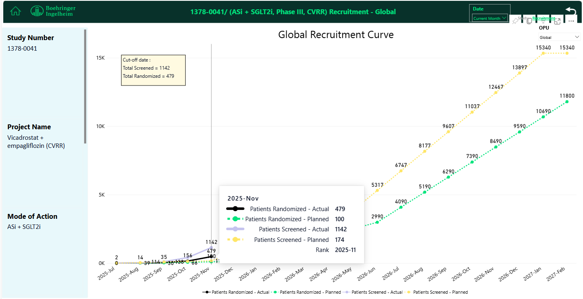

Slide 42
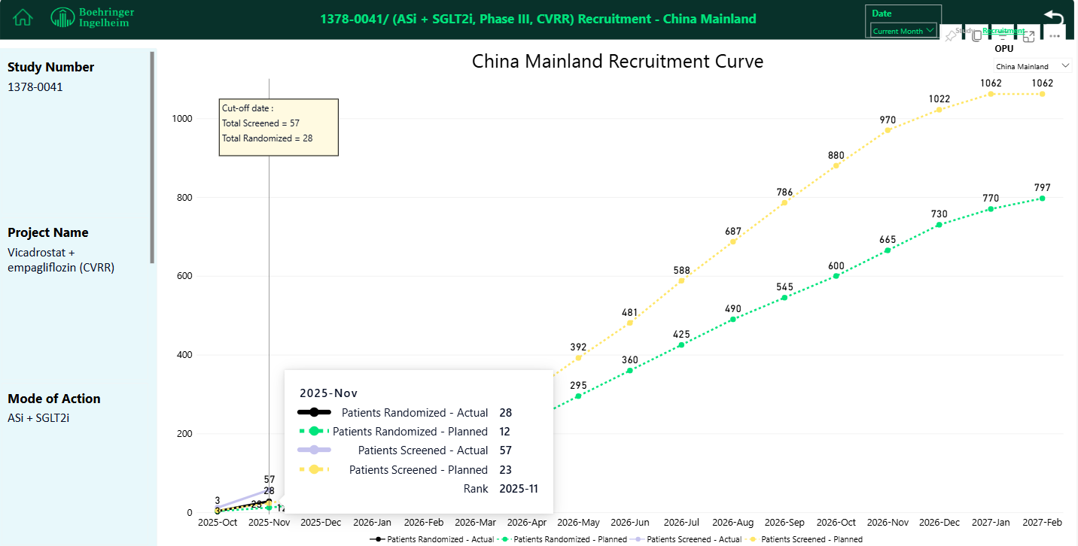

Slide 43
Projects/Studies with Red-Light
Project/study
Red-light starts from
VicaEmpa, ASi+SGLT-2i,
in CKD/EASi-KIDNEY, Ph-III
Apr 2025
Key issues
Continuously delayed timeline, and shortened recruitment window left
Fewer subjects and endpoint events are expected, potentially impacting Chinese subgroup result and indication approval
Mitigation actions
Monthly regular catch-up with CTL is ongoing to monitor trial progress
Global Medical and global brand team have been fully informed, and aware of the current situation, and will also look into the delay issue.
Status update
FSS(First Subject Screen) took place on 24th Aug, 2025, while no subject was randomized yet. Overall delay is ~ 4 months vs. original timeline(30th Apr, 2025)
13 sites activated with 38 patients screened, while no patient randomized yet
LSR(Last Subject Randomised) was still scheduled on 30th Aug, 2026
A global delay also occurred, and except Taiwan(88), no East Asian countries has randomized patients yet

Slide 44
Early Assets

Slide 45
Projects/Studies with Red-Light
Project/study
Red-light starts from
Avenciguat (sGCa.) in GN/1366-0015, PhIII
Jul. 2025
Key issues
RoFD decision pending since Apr due to undetermined global development strategy
Mitigation actions
Front-loading of certain trial start-up activities including CTP development, vendor setup and site selection to accelerate the trial initiation as soon as RoFD is released
Status update
RoFD is planned in Nov. TDO is final and site selection is ongoing.

Slide 46
Avenciguat (sGCa.), GN Development Plan
564 days
480 days
175 days
260 days
65 days
2026
2026
2027
2028
2029
2029
Today
1/5/26
final CTA package
1000 GN patients
4/9/26 - 6/7/28
global FSS to LSS
Global
1366-0015
Ph III
futility analysis DBL
100 GN patients
2/3/27
interim analysis DBL
Jul 5
300 IgAN patients
10/24/28 - 6/26/29
NDA sub. - app. for AA
2/5/26 - 5/6/26
CTA sub - app
105 GN patients (76 mainland, 21 TW, 8 HK)
China
1366-0015
Ph III
8/5/26 - 6/7/28
fSIV - LSS
Nov 24 - Nov 24
NDA sub. - app. for CA (best)
RoFD still pending; avenciguat townhall meeting scheduled on 19 Dec for update on HPBU EC meeting
CTA under preparation with planned submission on 05-Feb-2026
Final patient allocation confirmed: China mainland 76, Taiwan 21, Hongkong 8
FSS: first subject screened; LSS: last subject screened; AA: accelerated approval; CA: conditional approval; fSIV: first site initiation
GN: glomerulonephritides; IgAN: IgA nephropathy; FSGS: focal segmental glomerulosclerosis; MN: membranous nephropathy;
sGCa.: soluble guanylate cyclase activator

Slide 47
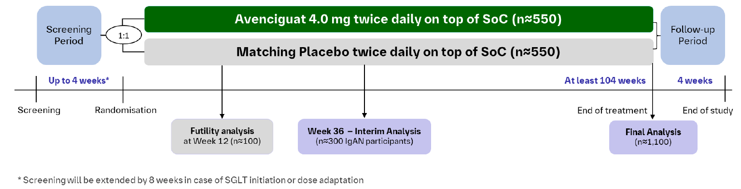
Avenciguat (sGC act.) in GN Ph III (1366-0015) trial design
Primary Endpoint for accelerated approval:
Change in proteinuria (UPCR based on first morning void) from randomization to month 9
Primary Endpoint for full approval:
total annualized eGFR slope from baseline to end of treatment (at least 24 months)
Key Inclusion criteria
≥12 years and 40 kg
eGFR ≥20 ml/min/1.73m2
UPCR >750 mg/g
Biopsy proven GN
On optimized/maximally tolerated RAASi, SGLT2i, MRA and ERA for ≥8 weeks
oral immunosuppressives on stable dose for ≥3 months
Key Exclusion criteria
rapid progressive kidney disease as measured by eGFR loss ≥ 50% over a period of 3 months prior to Screening
History of kidney transplant or planned kidney transplant
Systolic blood pressure <100 mmHg
i.v. immunosuppressive treatment ≤6 months

Slide 48
BI 764198 (TRPC6i), FSGS Development Plan
495 days
399 days
174 days
262 days
261 days
65 days
2025
2031
2025
2026
2027
2028
2029
2030
2031
Today
final CTA package
9/30/25
N=286
Global
1434-0017
Ph III
12/3/25 - 10/27/27
global FSS - LSS
interima analysis
5/10/29
key results
5/1/30
8/30/30 - 5/1/31
NDA sub - app
10/17/25 - 1/16/26
CTA sub-app
N=28 (mainland 18, TW 8, HK 2)
China
1434-0017
Ph III
4/16/26 - 10/27/27
fSIV - LSS
Jan 1 - Dec 31
China PK study (1434-0025)
9/30/2030 - 9/30/2031
NDA sub- app
RoFD endorsed on 18 Nov
BTD application approved on 26 Nov (global first)
Ph III preparation:
  CTA submission occurred on 17 Oct; clinical queries received on 10 Dec
  Global first EC approval received at 广东省人民医院
China Ph I PK study high level design received approval from global CPS committee
FSS: first subject screened; LSS: last subject screened; FSGS: focal segmental glomerulosclerosis; TRPC6i: transient receptor potential channel 6 inhibitor

Slide 49
Current trial design prior to potential new design elements
BI764198 20 mg once daily on top of SoC* (n=143)
Screening Period
1:1
Follow-up
Period
Matching Placebo once daily on top of SoC* (n=143)
Up to 4 weeks
104 weeks
4 weeks
Screening
(week -4)
Randomization
(Day 1)
Visit 8
(Week 52)
End of Treatment
(Week 104)
End of Study
(Week 108)
Primary Endpoint
Percentage change in 24-hour urinary protein-to-creatinine ratio (UPCR, measured in g/g) from baseline to Week 104
Key 2^{ary} Endpoint Family
Change in eGFR_{cys} measured in ml/min/1.73m² from baseline to Week 104
Treatment response, defined as 24-hr UPCR <1.0 g/g at Week 104
Other 2^{ary} Endpoints (all measured at wk 104)
treatment response, defined as 24-hr UPCR <1.0 g/g and eGFRcys ≥85% and no treatment failure during trial
complete remission, defined as 24-hr UPCR <0.3 g/g
change from baseline across Clinical Outcome Assessment (COA) KDQOL-36
Change from baseline across disease-specific COA NS-SIM-PRO at
Key Inclusion Criteria
≥12 years and 40 kg
eGFR ≥25 ml/min/1.73m²
UPCR >1,500 mg/g
diagnosis of
  Biopsy-proven primary FSGS OR
  FSGS related to a mutation in the TRPC6 gene
Optimized/maximally tolerated RAASi, SGLT2i, MRA, ERA, GLP1Ra for ≥8 weeks prior to screening
oral immunosuppressives on stable dose for ≥12 weeks prior to screening
patients on oral glucocorticoids have to be at a dose ≤10 mg/d prednisolone (or equivalent) 4 week prior to screening
Key Exclusion Criteria
Known mongenic or syndromic causes of FSGS (except TRPC6 gene mutation)
Rapid progressive kidney disease as measured by eGFR loss ≥ 50% over a period of 3 months prior to Screening
History of kidney transplant or planned kidney transplant
Clinical or histological evidence of secondary FSGS
i.v. immunosuppressive treatment ≤6 months prior to screening
Glucocorticoid naïve patients or re-exposure to high dose due to disease relapse (if Glucocorticoids and indicated and tolerated)
TRPC6i in pFSGS | CONFIDENTIAL

Slide 50
BI 764198 (TRPC6i), Podocytopathies Development Plan
381 days
289 days
69 days
64 days
2025
2028
2025
2026
2027
2028
Today
Final CTA package
Global
1434-0027
Ph II
11/28/25
N=132
2/4/26 - 7/22/27
FSS - LSS
key results
4/16/28
China
1434-0027
Ph II
7/11/25 - 10/9/25
pre-IND sub - feedback
12/12/25 - 3/19/26
CTA sub-app
N=14 (mainland 10, TW 4)
6/12/26 - 7/22/27
fSIV - LSS
Pre-IND final feedback received on 28 Nov. CDE insisted their initial position about diagnosis of pMN with biopsy only and diagnosis of Alport Syndrome with gene sequencing only.
  Team took immediate action to incorporate the changes in the ongoing local CTP amendment without shifting the target CTA submission date.
CTA submission occurred as planned on 12 Dec

Slide 51
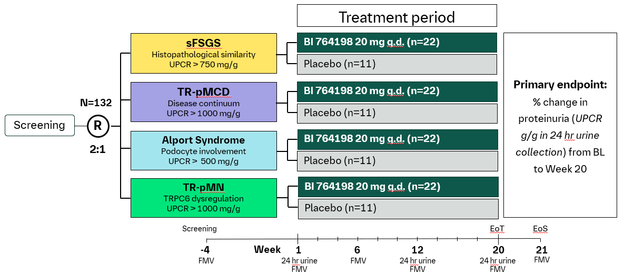
1434-0027 – Potential phase 2, multi-center, randomized, double-blind, placebo-controlled basket trial to evaluate BI 764198 in proteinuric glomerular diseases with podocyte involvement
Age ≥18 (≥12 for AS and MCD)
Biopsy proven disease (genetic diagnosis in AS, and serology in primary TR-MN are sufficient)
eGFR ≥25 ml/min/1.73m²
Optimized and stable SoC, including RAASi, SGLT2i and immunosuppressives (if indicated)
Increased UPCR (varies by aetiology)
Rapid progressive kidney disease as measured by eGFR loss
≥ 50% over a period of 3 months prior to Screening
History of kidney transplant or planned kidney transplant
IV immunosuppressive treatment ≤6 months prior to screening
Inclusion
criteria
Exclusion
criteria
Note: FSGS, focal segmental glomerulosclerosis; IA, interim analysis; MN, membranous nephropathy; sFSGS, secondary FSGS; R, randomization; TR-MCD: treatment-resistant minimal change disease; TRPC6, transient receptor potential canonical 6; UPCR, urine protein creatinine ratio; SoC, standard of care; FMV, first morning void​
TRPC6i in CKD with podocyte pathology | CONFIDENTIAL

Slide 52
289 days
179 days
65 days
30 days
2025
2028
BI 764198 (TRPC6i), DMD Development Plan
2025
2026
2027
2028
Today
pre-IND sub
11/26/25
Global
1434-0019
Ph II
Final CTA package
4/17/26
6/16/26 - 7/26/27
FSS- LSS
key results
5/4/28
China
1434-0019
Ph II
12/19/25 - 1/30/26
pre-IND sub - feedback
5/17/26 - 8/14/26
CTA sub-app
11/17/26 - 7/26/27
fSIV- LSS
Pre-IND under preparation with planned submission on 19 Dec. The review will follow the Type I HAI for 30 WD.
Prof. Dai, Yi (北京协和) and Prof. Hong, Siqi (重庆儿科医院) are nominated to participate in the Asia-centric ad-board meeting in Mar 2026
FSS: first subject screened; LSR: last subject randomized; FSGS: DMD: Duchenne Muscular Dystrophy; TRPC6i: transient receptor potential channel 6 inhibitor

Slide 53
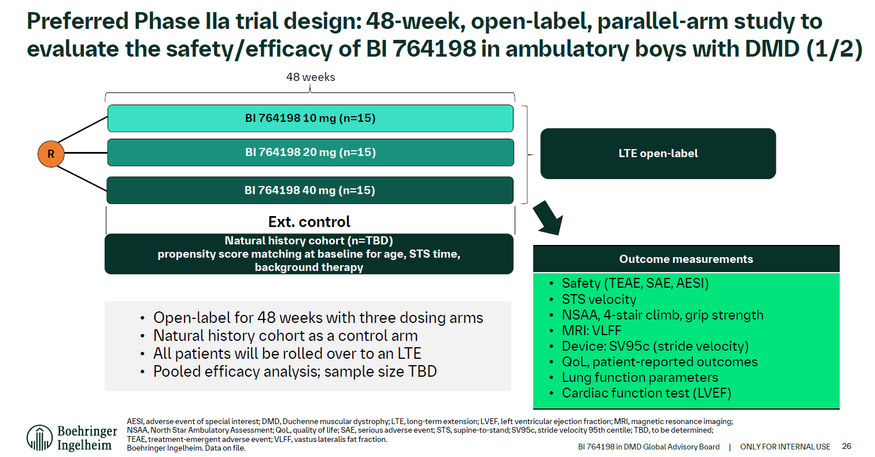

Slide 54
BI 3034701 (GGY2Ra.), Obesity Development Plan
96 days
65 days
65 days
47 days
2025
2025
2026
2027
Q4
Q1
Q2
Q3
Q4
Q1
Q2
Q3
Q4
2027
Today
Ph I readout for PoC
11/14/25
PoC release
Global
1507-0002
Ph II
11/26/25
Final CTA package
2/13/26
7/6/26 - 11/17/26
Ph II FSS - LSS
key results
12/27/27
China
1507-0002
Ph II
11/30/25 - 2/28/26
Ph II pre-IND sub - feedback
3/13/26 - 6/12/26
Ph II CTA sub - app
Recruitment window only 2 months (could be longer if new CTA process can be implemented)
9/11/26 - 11/17/26
China fSIV - LSS
2.5 months
PoC was achieved; the Ph I results are not released yet
Phase II design is under re-discussion for acceleration: Ph II/III seamless? Shortened maintenance dose period? Reduce dose groups?
China Pre-IND submission was cancelled because
  Global team doesn’t allow inclusion of any actual Ph I data in HAI BB before press release
  Safety margin is narrow and difficult to explain to CDE without actual data
  Mitigation strategy is to be planned once the data is released
China development proposal shared with global team for further discussion
China Leading PI candidate under final discussion

Slide 55
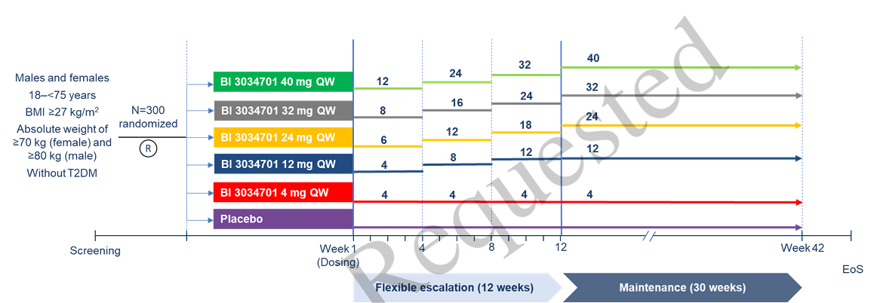
Phase II trial design (1507-0002) DRAFT for dose strategy consideration

Slide 56
TA Portfolio Key Update- BI 7703711 (SIRPa antagonist)
Asset Name-MoA | Indication | China Approval (base case) | Update | Next Step
BI 7703711 (SIRPa antagonist ) | MASH cirrhosis | Nov 2034 | <Global status> Phase 2a: On track. No safety signal seen yet. Go-criteria has been updated: A 20% Threshold for Pro-C3 Ph2b (1501-0005) planning: The operation module changed from Hybrid trial to in housing module. Initiate the draft TDO communication and country feasibility 3) Pre-IND for Ph2b is not planned by global team. | To monitor the global Ph2a results and Ph2b planning
 |  |  | <China status> 1) China to be kick-off the country and site allocation survey on phase 2b trial 2) Prof. Hong You attended the virtual 1:1 consultancy meeting and provided valuable comments on phase 2b design on 2nd Dec; 3) Prof. Minghua Zheng is recommended by local team to attend the in-person global advisory board meeting in Q1 2026. | Country and site allocation feedback by 21-Jan-2026 Continue to follow with global on involving Chinese experts opinion in the planning of Phase 2b.

Slide 57
TA Portfolio Key Update- BI 3802876 (FAP/TRAILR2)— MASH cirrhosis
Asset Name-MoA | Indication | China Approval (base case) | Update | Next Step
BI 3802876 (FAP/TRAILR2 biospecific antibody) MOA: halt/reverse liver fibrosis by removing FAP+ TRAILR2+ activated Hepatic Stellate Cells | MASH cirrhosis | Aug 2037 | <Global status> A slight increase in hs-cTNT indicating cardiovascular concerns was observed in Phase I among healthy volunteers. A Phase 2a trial (US and Canada only) will be initiated to demonstrate the anti-fibrosis effect and to assess the benefit-risk profile in MASH cirrhosis patients. | Global Phase 2a will be initiated in Dec 2025. 1st site SIV: Dec 2025 1st subject screen: Jan 2026
 |  |  | <China status> The joint Asian Phase 1 proposal with integrated timeline by China and Japan was endorsed by global team. Global team confirmed to deliver essential documents to support China and Japan HA interaction. | Continue to discuss with global team on target population for Asian Ph1

Slide 58
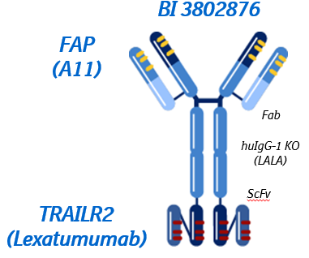
Asset overview
Drug candidate
  BI 3802876 is a bispecific molecule binding FAP and TRAILR2.
Clinical hypothesis
  Selectively removing FAP+ TRAILR2+ activated Hepatic Stellate Cells will halt/reverse liver fibrosis
Unique MOA
  Directly targeting the source of liver fibrosis
  FAP binding provides cell specificity and clusters TRAILR2 mediates cell killing
Indication
  NASH cF4 is a sentinel population with the potential to expand to other etiologies as a Pan-Cirrhotic Therapy
Treatment paradigm
  Intravenous drug, monthly or longer
  Short term/Cycling/Induction therapy
Competition
  No direct clinical competition for MoA in MASH
Pre-clinical results
  Demonstrated anti-fibrotic PoC in LiverChip (in vitro) fibrosis model with clinically relevant biomarkers (see next slide)
Phase I results
  BI 3802876 may cause small increases in hs-cTnT, which are of uncertain clinical significance at this time.

Slide 59
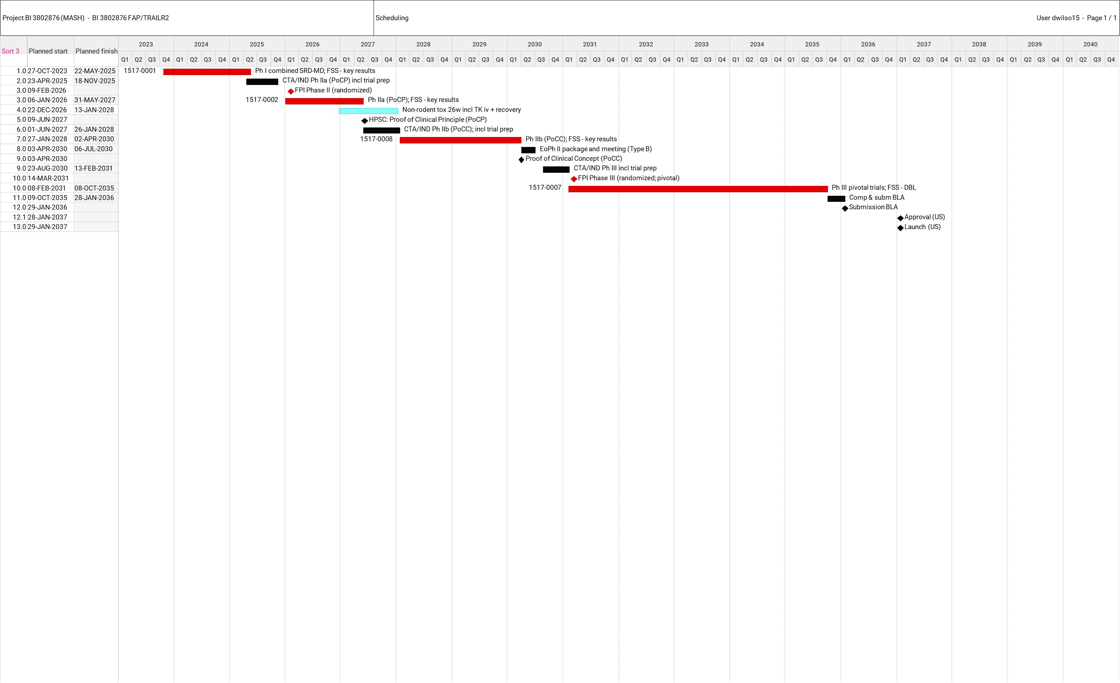
Global clinical development timeline and China integration plan
China Integration Plan:
China will be included in the global development program beginning with the Phase IIb (PoCC) trial.
The Phase IIa PoCP trial is restricted to sites in the US and Canada only.
Asian Phase 1 Plan:
Objectives: 1) Collect data from Chinese participants to support advancement to subsequent trial phases; 2) Potentially waive the need for a separate China PK study for registration purposes.
Trial design: Similar to the global Phase IIa but simplified.
Tentative timeline: Q1-Q3 2027 (very preliminary).
Current status: Proposal has not yet submitted to IUPC.

Slide 60
Template for reference

Slide 61
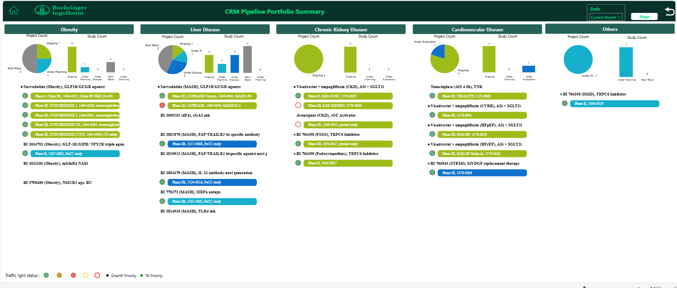
TA CRM Portfolio Summary - Pipeline Projects
template
New projects/studies:
  e.g. Project name, MoA. Additional comments if needed.
Status change: (e.g. →ongoing/under planning/under evaluation)
  e.g. Project name, MoA,, xxxx-1234, Ph II→ongoing. Additional comments if needed.
Completion/Termination:
  e.g. Project name, MoA, xxxx-1234, Ph III completed. Additional comments if needed.
Please label the projects/ studies with the appropriate changes as needed.
Guide for template use
Please focus on the portfolio changes.
A summary report can be exported from the TCM asset dashboard.

Slide 62
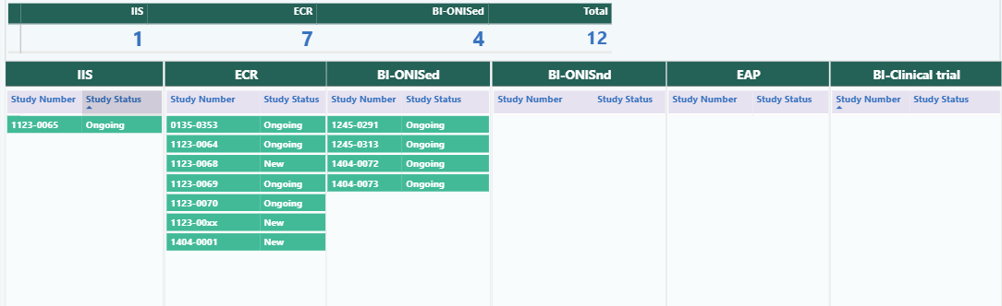

TA CRM Portfolio Summary - PMS Studies
template
Please label the studies with the appropriate changes as needed.
New studies:
  e.g. xxxx-1234, (study short description, e.g. ORIENTAL, Real-world study of Jardiance in Chinese patients with HFpEF), Additional comments if needed.
Status change: (to ongoing)
  e.g. xxxx-1234, (study short description)→ongoing. Additional comments if needed.
Completion/Termination:
  e.g. xxxx-1234, completed, Additional comments if needed.
Guide for template use
Please focus on the portfolio changes.
A summary report can be exported from PMS dashboard.
The traffic light status needs to be manually added to the slide.

Slide 63
Projects/Studies with Red-Light
Guide for template use
template
Please provide details for pipeline project/studies and PMS studies with red-light and add additional slides if needed.
Project/study
Red-light starts from
e.g. BI123456, MoA in Obesity/XXXX-1234, PhII
e.g. Aug 2025
Key issues
***
Mitigation actions
***
Status update
***

Slide 64


Guidance on Portfolio Highlights
Content
Format
Each TA may define the contents of its portfolio highlights according to TA presentation needs.
Please ensure that updates on key projects and key studies(e.g. recruitment curve) within the TA are included.
The templates for the development plan and recruitment curve in slides 8 and 9 can be used as references and adapted as needed to suit the TA’s requirements.

Slide 65


BI 123456/INN (MoA), indication Development Plan
template
2025 |  |  |  | 2026 |  |  |  | 2027 |  |  |  | 2028 |  |  |  | 2029 |  | 20230
Q1 | Q2 | Q3 | Q4 | Q1 | Q2 | Q3 | Q4 | Q1 | Q2 | Q3 | Q4 | Q1 | Q2 | Q3 | Q4 | H1 | H2 | H1 | H2
Jun 2025
Jul 2026
Mar 2027
Aug 2027
Dec 2027
Updates on the project and studies for global
Ph2/3-
xxxx-xxxx
Ph2/3, N=***
FPI
LPI
Key results
NDA sub.
NDA app.
Apr 2027
BTD sub.
Apr 2025
17 Nov 2025
Jul 2026
Mar 2027
Sep 2027
Sep 2028
CTA Review + EC + HGRAC + 1st SIV
Ph2/3, N=**
Ph2/3-
xxxx-xxxx
CTA Sub
1st SIV
LPI
Key results
NDA sub.
NDA app.
Apr/May 2027
BTD sub.
Updates on the project and studies for China
Guide for template use
The template can be adjusted based on project needs.
65

Slide 66
xxxx-xxxx BI 123456/INN indication Global/China Recruitment
template
Cut-off date: 2024.1.2
Total Screened : xxx
Total Randomized: xxx
Total Screen failure: xxx
In screening : xxx
Screen failure rate = xx %

